Slide 1
Video Sharing Platform
-Yuvraj Subedi
-Kyle Lugo

Slide 2
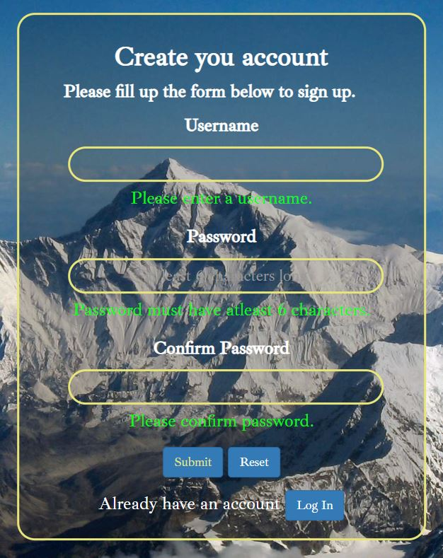
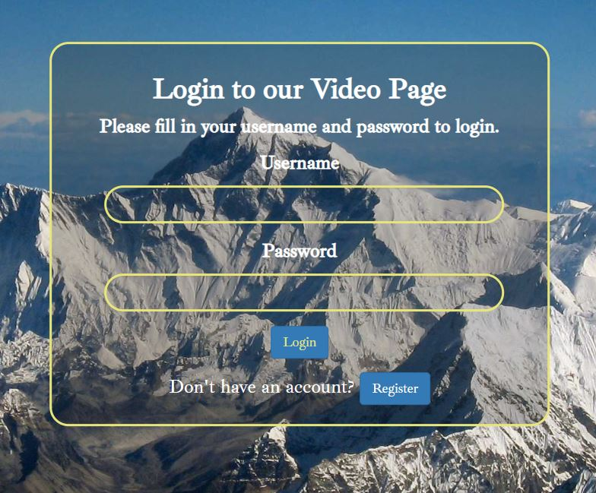
Register and Login

Slide 3
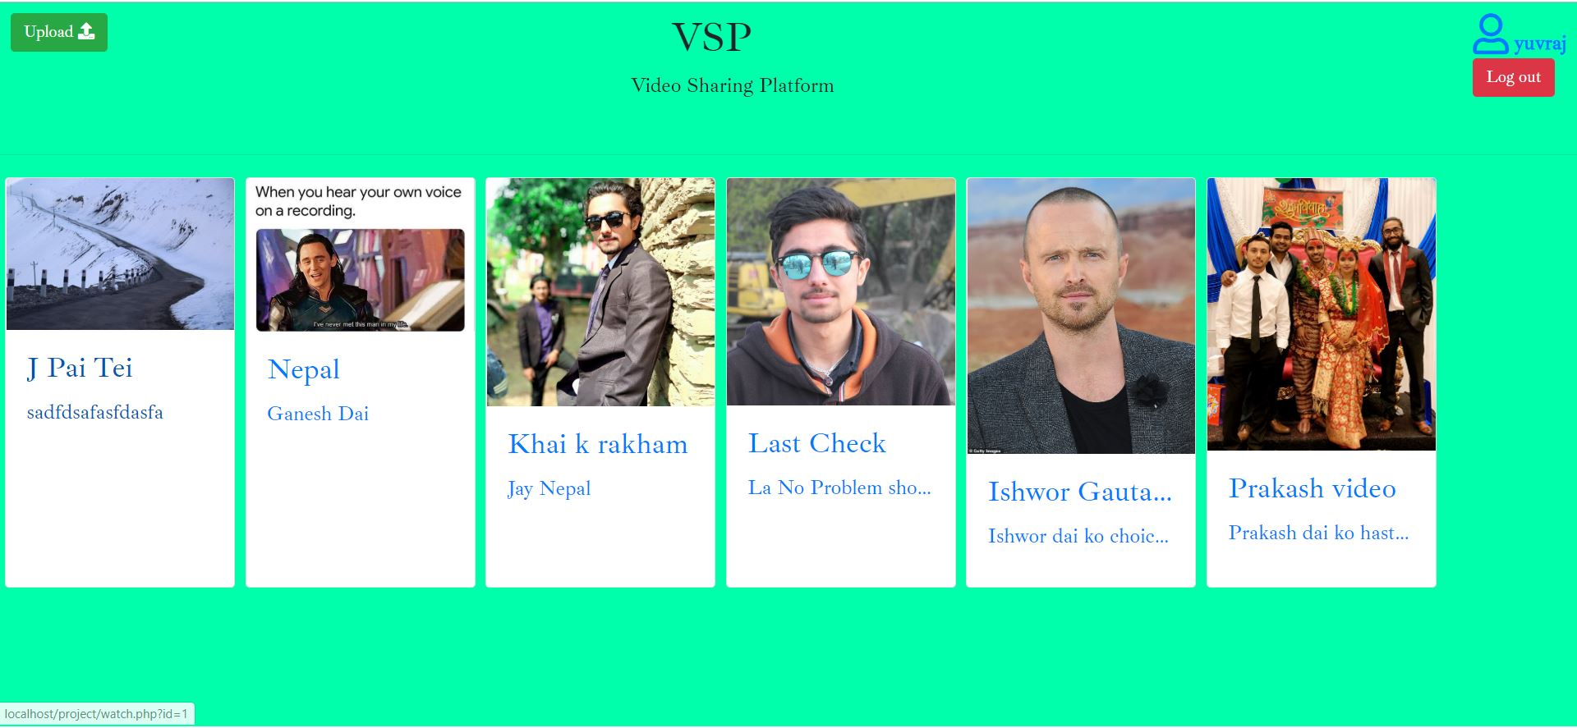
Homepage

Slide 4
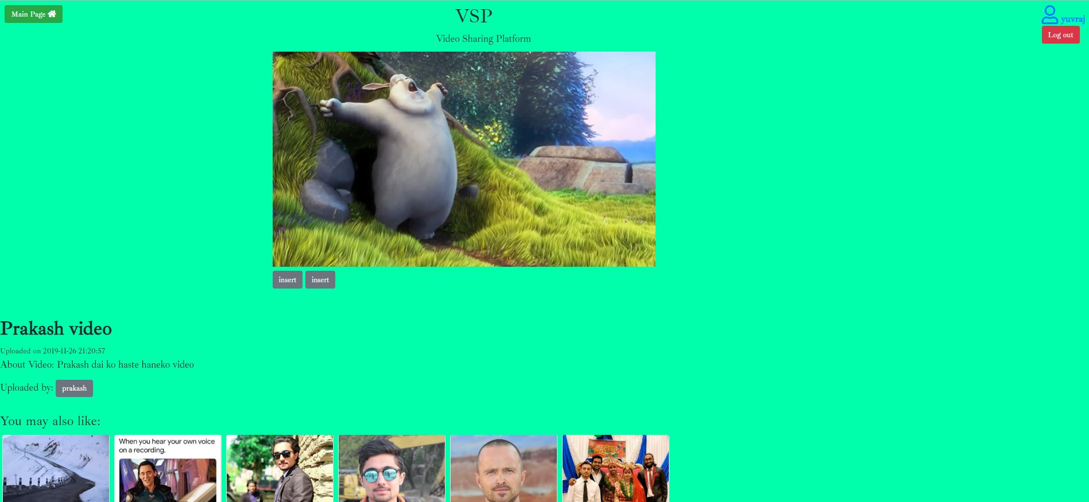
Video Playing page

Slide 5
System Design of vsp
Register (Client) Database (Client credentials)
Login (Client) Database (verify and store)
Video Sharing Platform Upload video Uploaded video in server storage
Watch Uploaded Videos

Slide 6
Issues Encountered
Connecting to AWS RDS system, storing videos to the AWS bucket.
Tried to set up sftp connection to upload files to the pausch through HTML forms and later only figured out, pausch is not configured to allow html forms to upload files to their server.
set up an AWS S3 bucket so that we could host the videos on AWS, but we ended up not using it after moving the website to Pausch since we would have had to install the AWS SDK

Slide 7
Future work
Adding like, comment, share options for the videos.
Linking user account to their email so that they can recover their account if they forget their password.
Making users able to log in through their email without signing up.
Counting number of views and put the videos on trending list.

Slide 8
Thank you

